Slide 1

WHATSAPP UX
ANNA ROSE BIJOY•NOV 2021

Slide 2
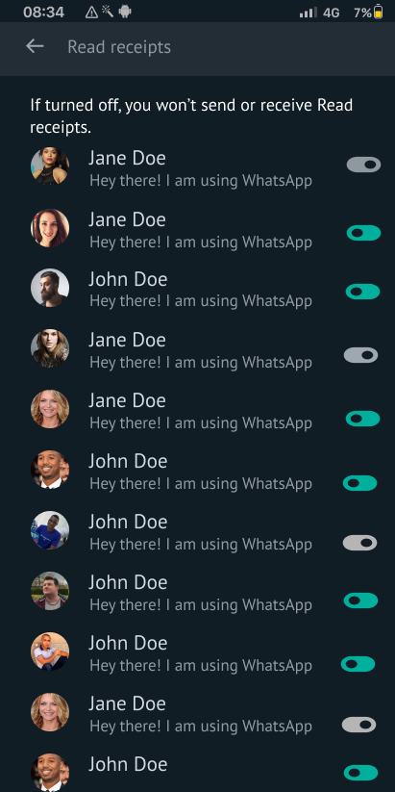
Read receipt
Read receipt turn off and on for each person and group.
Unimportant persons and groups can be turned off while keeping the important ones turned on.

Slide 3
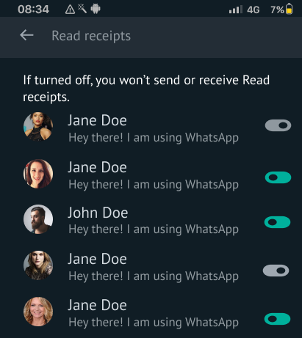
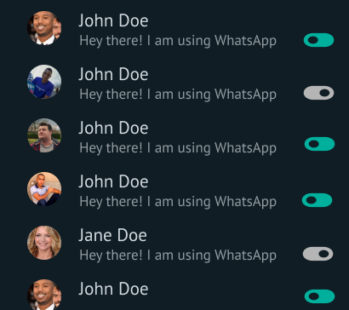
Read receipt

Slide 4
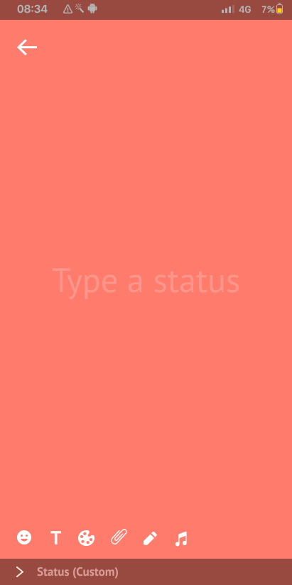
Custom status
Included add image, pen tool and add music icons to make better customised status.

Slide 5
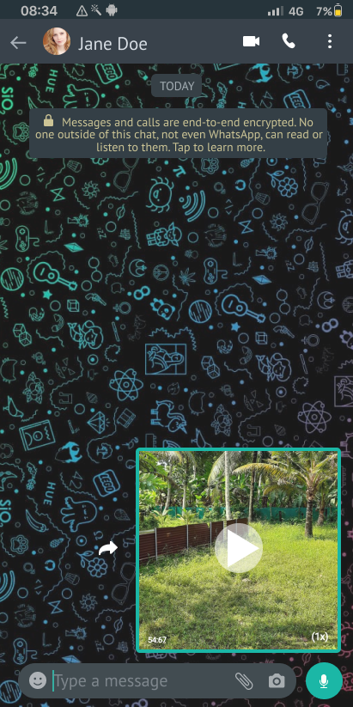
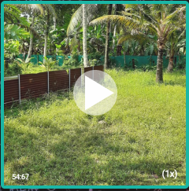
Video sent
Included fast forward button for forwarded videos.

Slide 6
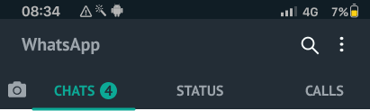
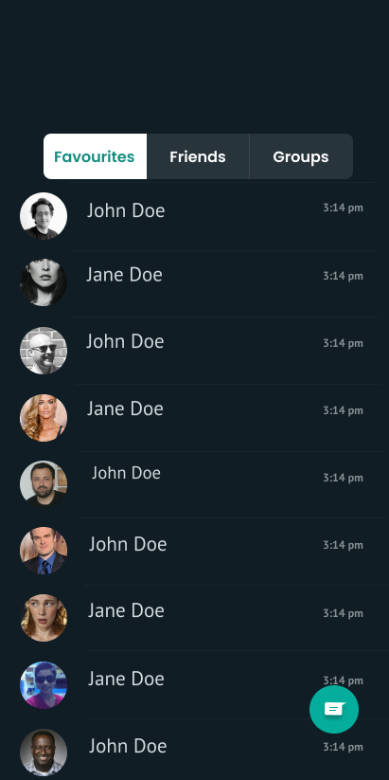
Chat
Divided chat into favorites, friends and groups to oraganize and easy accessing.

Slide 7
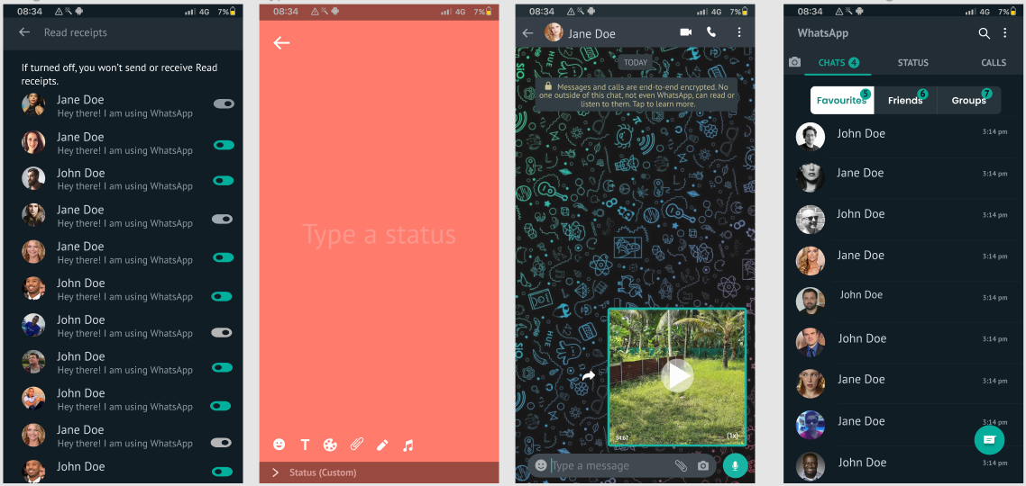

Slide 8
Thank you.

